Slide 1
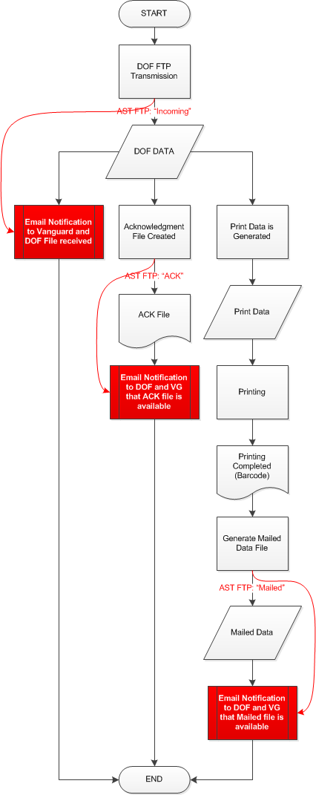
DOF FTP
1. DATA from DOF FTP (Push or pull)?
AST FTP
nycdofcn\BTSFLAT
incoming
2. ACK file to DOF
ack
3. Mailed data file to DOF
mailed
Need FTP Email Notification
VG
Need FTP Email Notification
OLD PROCESS (OLD FTP: nycdof\CMVTStickers\archive)
DOF FTP sends data to AST FTP AST FTP sends email notification of receipt of DATA FILES.
Files are printed and mailed.
NEW PROCESS (NEW FTP: nycdofcn\BTSFLAT)
DOF FTP sends data to AST FTP Email for receipt of DATA FILES.
AST script processes data; returns an acknowledge data file to DOF FTP. Email for availability of ACK FILES.
After job is printed and mailed, AST script sends a data file containing records mailed to DOF FTP. Email for availability of MAILED FILES.

